Slide 1
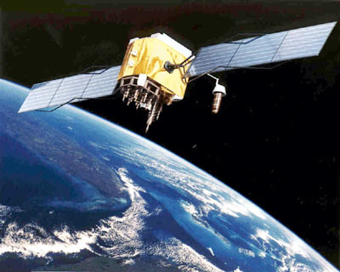
GLOBAL POSITIONING SYSTEMS (GPS) BASED VEHICLE MONITOR

Slide 2
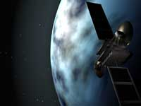
AGENDA
Introduction to GPS
Introduction to arduino
Necessity of technology
Architecture and design
Functionality
Utilities and Applications

Slide 3
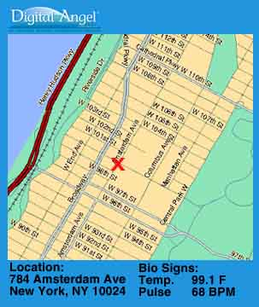
INTRODUCTION
GPS tracking means to trace something or someone with the Global Positioning System.
The GPS consists of a set of 24 operational satellites and land-based control stations.
The system was designed for and is operated by the U. S. military, owned by the US Department of Defense (DoD).
Since 1994 the Global Positioning System has been available for civilian use at no cost.
By using GPS satellites, local land-based networks and wireless radio signals LT will find you, wherever you are.

Slide 4
NECESSITY OF TECHNOLOGY
Department of Defense were facing challenges to increase security of the US.
During emergencies we require immediate tracking of important people.
Logistic companies need tracing of their fleet for reliable operations.
Personal valuables vehicles and goods when stolen or lost were not easier to locate.

Slide 5
ARCHITECTURE AND DESIGN
Three major segments
SPACE
GPS
CONTROL
USER

Slide 6
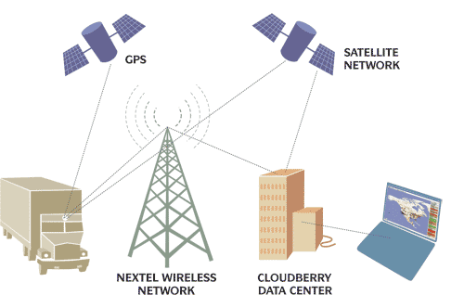
USER SEGMENT

Slide 7

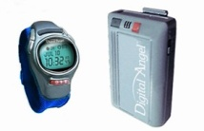

USER SEGMENT
The user segment consists of GPS-receivers, located in cars, planes or even in GPS collars for wildlife.
They can be as small as a mobile phone.
Handheld
Biosensor

Slide 8
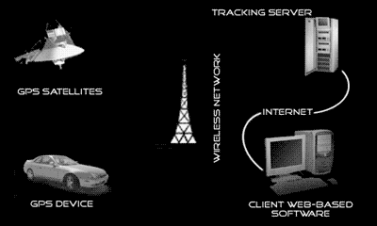
VEHICLE TRACKING

Slide 9
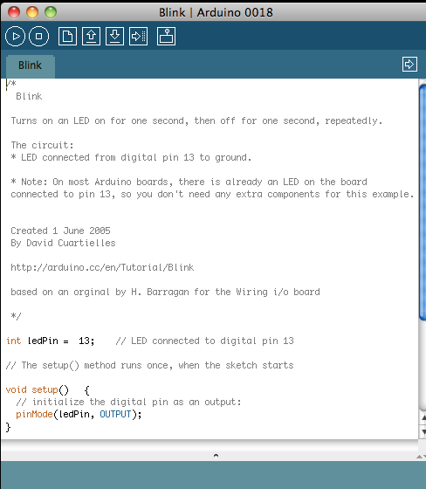
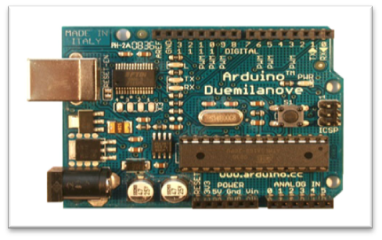
WHAT IS ARDUINO?
Physical computing platform
Open source
“Hardware Abstracted” Wiring
Language
USB programmable
Large community
Multi platform Win/Mac/Linux
Inexpensive
$31.95 Sparkfun Electronics
$34.99 Radioshack

Slide 10
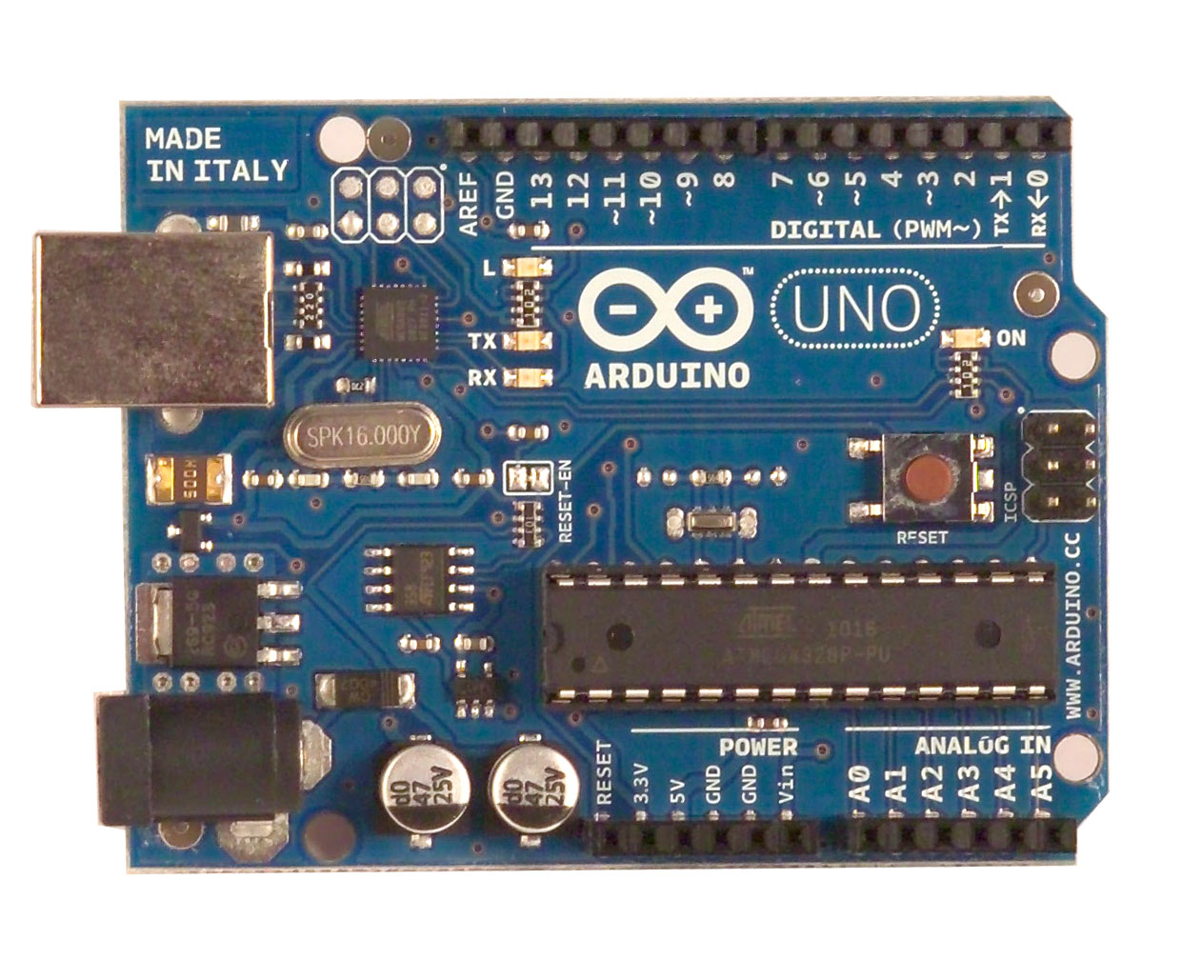
Digital Input/Output Pins
Pins with ~ are PWM
[Analog Output]
Transmitter/Receiver
Serial Connection
GRD
Microcontroller ATmega328
Operating Voltage 5V
Input Voltage (recommended)7-12V
Input Voltage (limits)6-20V
Digital I/O Pins 14
(of which 6 provide PWM output)
Analog Input Pins 6
DC Current per I/O Pin 40 mA
DC Current for 3.3V Pin 50 mA
USB
7-12 v
3 v
5 v
GRD
Analog Input Pins

Slide 11
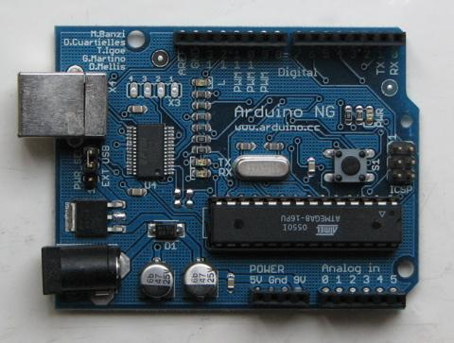
WHAT IS ARDUINO?
Based on ATmega328 – 8
BIT
w. USB interface
Voltage regulator
Specs
  RISC @ 16 Mhz, 20 MIPS
  32 K Memory
  6 Ch 10 Bit A/D
  PWM, I2C, SPI
The “power” is in:
- Standard board design
- Wiring language
- Open Source

Slide 12
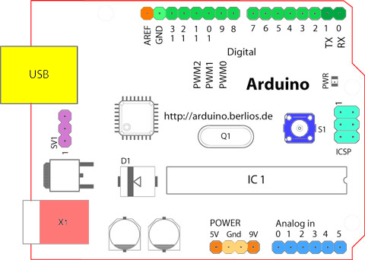
ARDUINO BOARD OVERVIEW

Slide 13
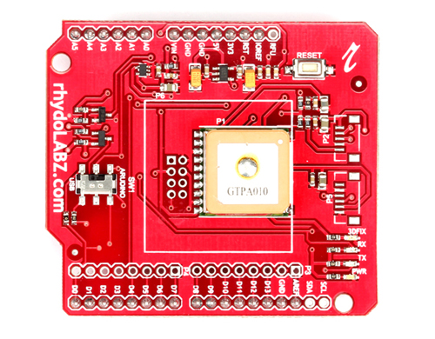
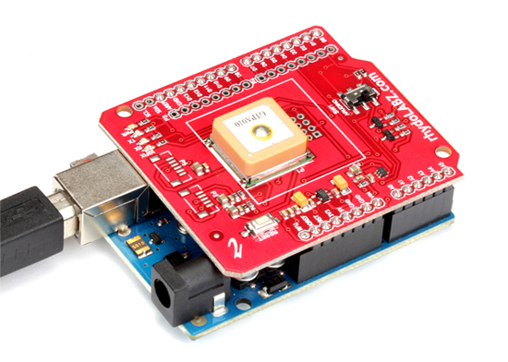
GPS shield on arduino
With this GPS Shield populated
with GPS module you can add
GPS functionality to your Arduino.
You can receive the NMEA data on
your PC/Laptop with a easiness of
sliding a switch.

Slide 14

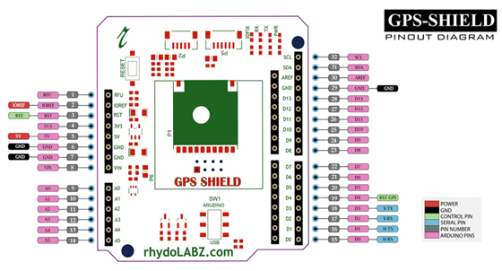
The DPDT switch(SW1) switches the GPS module's input/output between Arduino's and USB Transceiver .
So as to get NMEA data on PC via USB connector on ARDUINO board.
This feature help you to verify the GPS data and test its functionalities before doing and coding on arduino.

Slide 15
FUNCTIONALITY
GPS receiver has to know two things:
The location of at least three satellites above you.
The distance between you and each of those satellites
A GPS receiver's job is to locate three or more GPS satellites, figure out the distance to each, and use this information to deduce its own location.
This operation is based on a simple mathematical principle called trilateration.

Slide 16
EXPLANATION (TRILATERATION)
Satellite 1
100 km
Satellite 1 detect the receiver with in the radius of 100 km

Slide 17
EXPLANATION (TRILATERATION)
Satellite 1
200 km
100 km
Satellite 2
Satellite 2 detect the receiver with in the radius of 200 km

Slide 18
EXPLANATION (TRILATERATION)
50 km
Satellite 3
200 km
Satellite 1
100 km
Satellite 2
Satellite 3 detect the receiver with in the radius of 50 km

Slide 19
EXPLANATION (TRILATERATION)
50 km
Satellite 3
200 km
Satellite 1
Satellite 2
100 km
The intersection point of these three circles will be the exact location of Target

Slide 20
HOW SATELLITE MEASURES THE DISTANCE
EARTH
Satellite
Rx on Earth
Time Delay * velocity of light = Distance
Periodic simultaneous Transmission b/w Satellite and Rx on Earth station

Slide 21
MEASURING DISTANCE EXPLANATION
The receiver and satellite both need clocks that can be synchronized down to the nanosecond.
For best synchronization Atomic clocks are required at both ends.
But atomic clocks cost somewhere between $50,000 and $100,000, which makes them a just a bit too expensive for everyday consumer use.
The Global Positioning System has a clever, effective solution to this problem. Every satellite contains an expensive atomic clock, but the receiver itself uses an ordinary quartz clock, which it constantly resets.

Slide 22
UTILITES & APPLICATION
Vehicle Fleet Tracking
GPS Single Vehicle Tracking
GPS Data Logging
Real Time Tracking

Slide 23
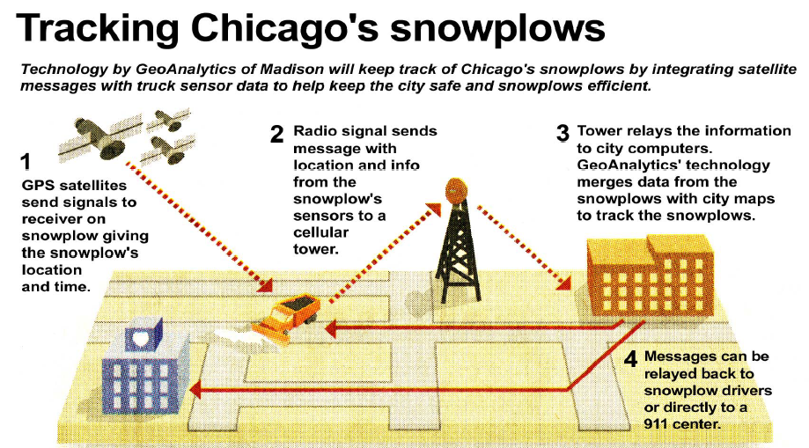
UTILITES & APPLICATION

Slide 24
0VER ALL WORKING
First this GPS in the vehicle receives latitude and longitude values of present location using outer space satellites.
These values obtained are stored in SD card.
When this SD card is interfaced to google maps, the vehicle navigation is shown.

Slide 25
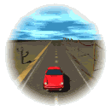
REAL TIME VEHICLE TRACKING

Slide 26
PRIOR USE
It doesn’t matter where you are sitting at your home or office you can still keep a track of your vehicle.
If you can track your vehicle then you will able to see what route your drivers is taking to deliver the consignment to the base and what kind of handling your driver is providing to the vehicle, is it safe or not.

Slide 27
Thank You

